Slide 1

Real Time Pose Estimation
OpenCV

Slide 2
Problem
Real Time Application
Estimate camera pose based on:
Another similar camera with a known camera position & orientation
Unique feature points in both images (2D & 3D coordinates)
Camera calibration parameters

Slide 3
Theory
Estimate the camera pose from n 3D-to-2D point correspondences
Most general version requires estimating:
The 6 degrees of freedom of the pose
5 calibration parameters: focal length, principal point, aspect ratio and skew
Perspective-*n*-Point problem

Slide 4
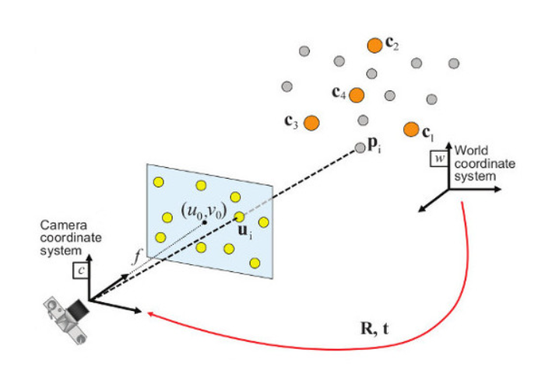
Perspective-*n*-Point Problem
Given a set of correspondences between 3D points expressed in a world reference frame and their 2D projections onto the image, we seek to retrieve the pose (rotation and translation) of the camera with known properties.

Slide 5
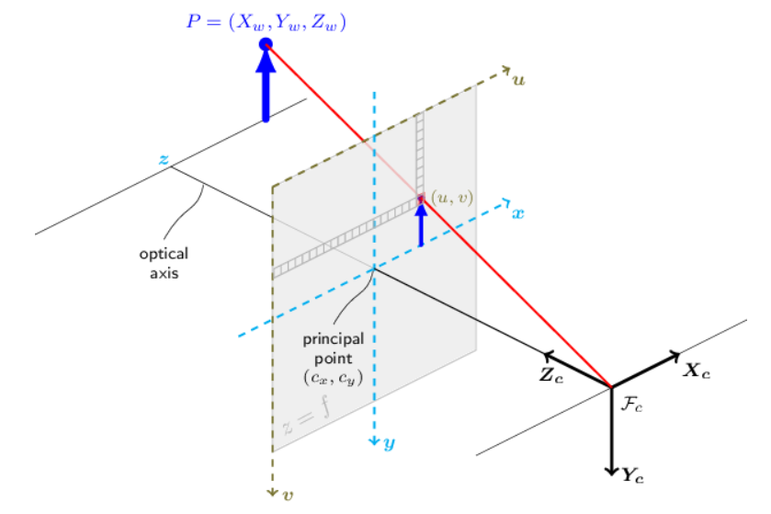

Pinhole Camera Model
The view of a scene: projecting a scene's 3D point $Pw$ into the image plane using a perspective transformation which forms the corresponding pixel $p$
$$Pw\left(x, y, z\right)→p\left(u, v\right)$$
$$s ∗p=A ∗ \left[R|t\right] ∗Pw$$
$Pw$: 3D point in the world coordinate system
$p$: 2D pixel in the image plane
$A$: camera intrinsic matrix
$R$ and $t$: rotation and translation
Describe the change of coordinates from world to camera coordinate systems
$s$: projective transformation's arbitrary scaling
NOT part of the camera model

Slide 6

Intrinsic Parameters
The camera intrinsic matrix A projects 3D points given in the camera coordinate system to 2D pixel coordinates
The camera intrinsic matrix A is composed of the focal lengths fx and fy, which are expressed in pixel units, and the principal point (cx,cy), that is usually close to the image center
$A= \left[\begin{matrix}fx & 0 & 0 \\ 0 & fy & 0 \\ cx & cy & 1\end{matrix}\right]$
$s ∗ \left[\begin{matrix}u \\ v \\ 1\end{matrix}\right]= \left[\begin{matrix}fx & 0 & 0 \\ 0 & fy & 0 \\ cx & cy & 1\end{matrix}\right] ∗ \left[\begin{matrix}x \\ y \\ z\end{matrix}\right]$
The matrix of intrinsic parameters does not depend on the scene viewed
Can be reused as long as the focal length is fixed

Slide 7

Extrinsic Parameters (1)
$\left[R|t\right]$: matrix product of a projective transformation and a homogeneous transformation
The projective transformation maps 3D points represented in camera coordinates to 2D points in the image plane and represented in normalized camera coordinates $x^{′}= x/z$ and $y^{′}= y/z$
$$z ∗ \left[\begin{matrix}x^{′} \\ y^{′} \\ 1\end{matrix}\right]= \left[\begin{matrix}1 & 0 & 0 & 0 \\ 0 & 1 & 0 & 0 \\ 0 & 0 & 1 & 0\end{matrix}\right]∗ \left[\begin{matrix}x \\ y \\ z \\ 1\end{matrix}\right]$$

Slide 8

Extrinsic Parameters (2)
$\left[R|t\right]$: matrix product of a projective transformation and a homogeneous transformation
The homogeneous transformation:
Encoded by the extrinsic parameters $R$ and $t$
Represents the change of basis from world coordinate system to the camera coordinate system
$$p= \left[\begin{matrix}R & t \\ 0 & 1\end{matrix}\right] ∗Pw$$
$$\left[\begin{matrix}R & t \\ 0 & 1\end{matrix}\right]= \left[\begin{matrix}r11 & r12 & r13 & tx \\ r21 & r22 & r23 & ty \\ r31 & r32 & r33 & tz \\ 0 & 0 & 0 & 1\end{matrix}\right]$$

Slide 9
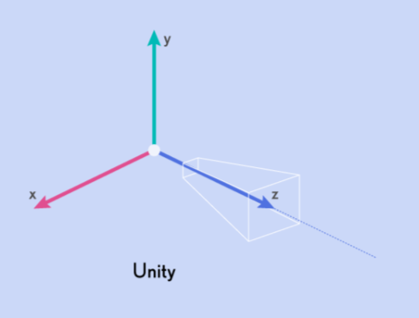
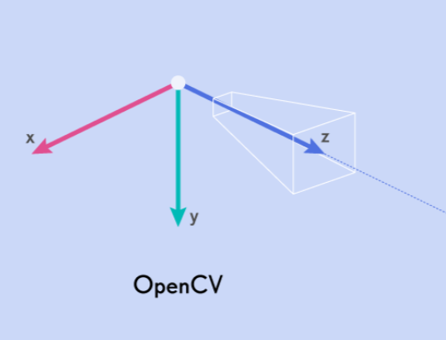
Unity vs OpenCV Coordinate System
Position: tx, ty, tz
Rotation: x, y, z, w
Position: tx, -ty, tz
Rotation: -x, y, -z, w

Slide 10
Quaternion vs Rotation Vector vs Rotation Matrix (1)
Rotation vectors represent rotations by directly storing the axis of rotation and the angle magnitude
Quaternions are much easier to compute
Matrices and quaternions are much more appropriate rotational representations
Quaternions are more compact and they are also quite easy to convert into an axis-angle representation (and back again) though using trigonometry
Quaternions are just a kind of axis-angle representation, but with implicitly encoded sines and cosines, which are needed for efficient transformation and computation

Slide 11
Quaternion vs Rotation Vector vs Rotation Matrix (2)
What do you do when you want to concatenate two rotations in vector representation?
You have to convert them to quaternion or matrix form (using costly trigonometry)
Quaternions can be concatenated efficiently by using the classical quaternion multiplication
What do you do when you want to rotate a point/vector using a rotation in vector-format?
You convert it into a matrix (using costly trigonometry)
A quaternion quite efficiently converted into a matrix

Slide 12
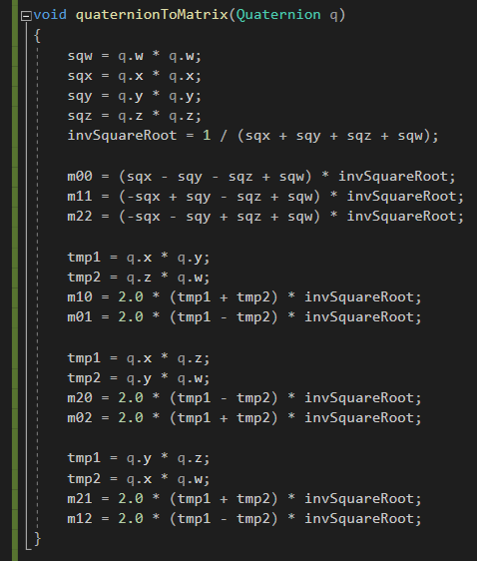
Quaternion to Rotation Matrix

Slide 13
Rotation Matrix to Quaternion (1)
Avoid division by zero
Avoid square root of a negative number
Accuracy of dividing by (and square rooting) a very small number
Resilient to a deorthogonalised matrix

Slide 14
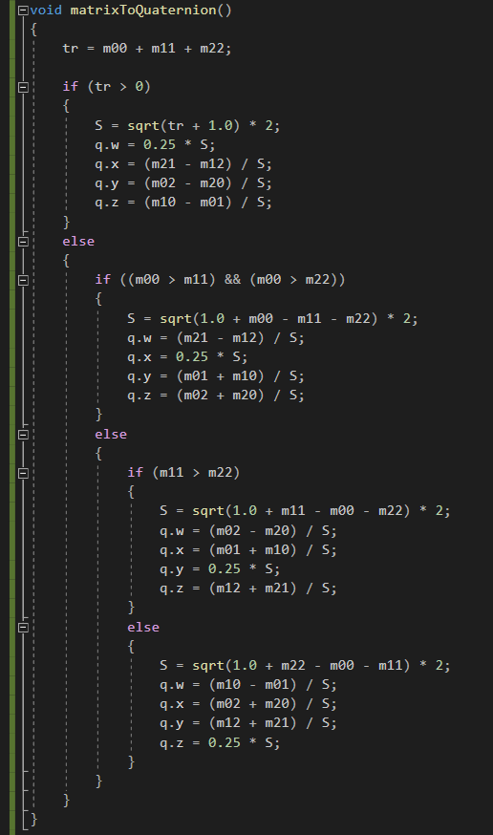
Rotation Matrix to Quaternion (2)

